Slide 1
System and Network Administration
Operating System Essentials

Slide 2
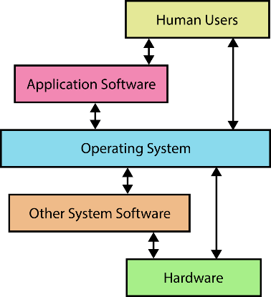
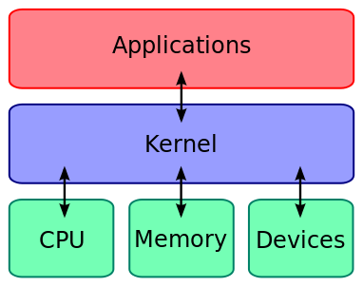
OS in Summary
Device DriverSoftware

Slide 3
Operating Systems
The operating system consists of a kernel along with hundreds of specialized programs for particular tasks.
Provides access to frequently needed facilities
Shields user from low-level details
but not system and network administrators!
User Interface: Command Line, Curses, GUI
The most complete administrative interface is the command line. GUI and Web based administration are possible, but don’t always offer the same number of configuration options.
Windows: Command Prompt or powershell
Notes:
OS – software to share and control hardware resources of a device
HIDING complexity
Access via system calls
Hopefully STANDARDIZED system calls
POSIX is such a standard (Portable OS interface, IEEE)
Makes programming easier in terms of access to facilities
User interface developed historically via command line and graphical interfaces
First Windows offerings were an interesting stretch of the term “operating system”

Slide 4
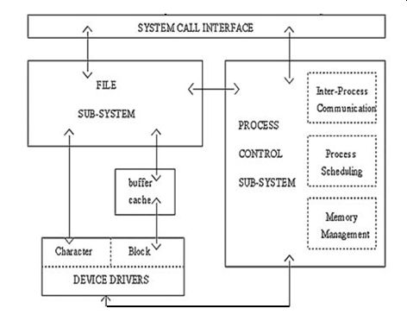
Command processor (shell) provides a convenient interface to the system call libraries for:
I/O control system
Process control management and interprocess communication
Memory management
Storage management
File management
Network management, communication support, and communication interfaces

Slide 5
Files, Devices, Device Drivers
All of the functions used to access a specific device are jointly referred to as the device driver.
Device drivers must be statically compiled into the kernel or stored on disk as a loadable module.
In kernel space, the virtual file system (VFS) decodes the file type and transfers the file operations to the appropriate channel, like a filesystem module in case of a regular file or directory, or a device driver in case of a device file.

Slide 6
Layers of Complex Software
Any complete OS (Win, OSX, Linux)
VM (Guest OS)
A “Level 2 Hypervisor” runs as a regular app and exposes virtual devices to the “Guest OS”
Device Drivers
Virtual Devices
Other
Apps
VirtualBox
or Vmware, Docker, Android Studio, etc.
Virtual Drivers
Windows (Host OS)
The “Host OS” passes virtual driver instructions to the CPU through its “real” device drivers
Device Drivers
--- --- --- Hardware --- --- ---
Every operating system is complex software all by itself
To run one OS inside another OS (as a Virtual Machine), we need a “translation layer”

Slide 7
Processes and Services
Each process is a collection of resources:
Instance of a running program in RAM, current directory, open files with current position, etc…
Processes are “time-sliced” by OS scheduler
Various policies and queues of waiting processes
A “Service” is a background process that performs a specific function or system task (often called a “daemon” in unix)
Usually started at boot time, and runs as long as the system is up

Slide 8
Shutdown
Complex systems need safe shutdown sequence to avoid damage
Quiescent state difficult to predict in multi-tasking systems
Complete all operations in progress
Prevent new operations from starting
Close files
Terminate processes and services
Synchronise and Flush buffers/caches
Dismount/park/eject disks
Power off !
Notes:
Network Administration - Managing Hosts and Users
11/23/2021
8
Given that shutdown sequence processing is now mostly automatic, one thing remains to remember: DO NOT INTERRUPT THE SHUTDOWN SEQUENCE.

Slide 9
Caution!
Running VMs on a laptop:
Check your power settings – close lid, low battery, etc.
Never Hibernate, only Sleep
(“Hibernate” suspends too many host processes, and your VM will get corrupted – “Sleep” works well enough)
(or … just poweroff the VM)

Slide 10




Slide 11
Permissions
Every process and every system resource has a single owner
Every owner has a unique User ID (UID) and belongs to one or more Groups identified by a Group ID (GID)
The owner can give a group access to the resource. Anyone else is just the world at large.
Permissions limit reading, writing, execution
Superuser privileges override all explicit privileges
root (unix), Administrator (Windows)

Slide 12
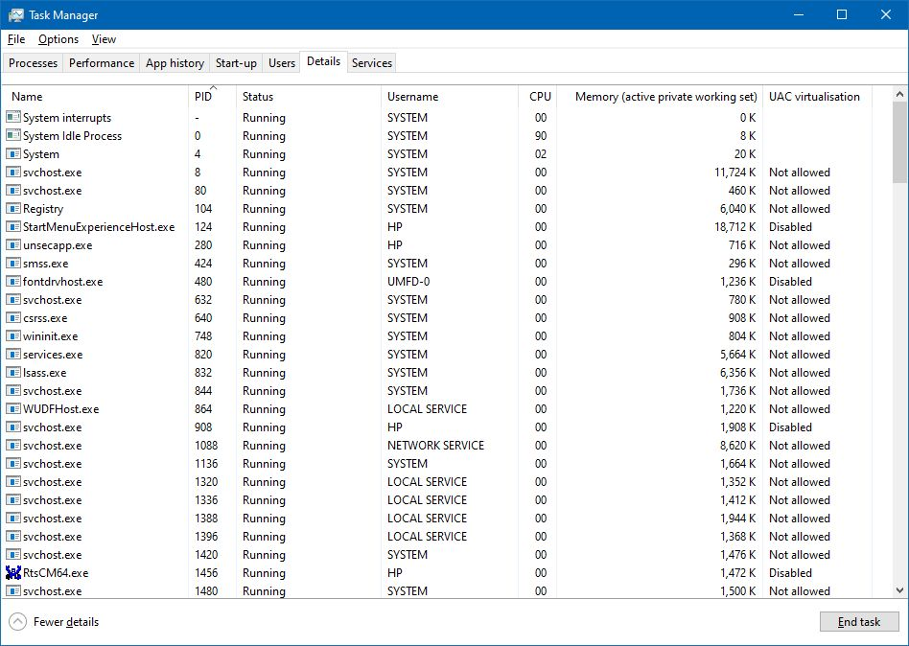
Task Manager: Process Details
Every
Process
has an
Owner
(User or Group)
PID =
Process
ID

Slide 13
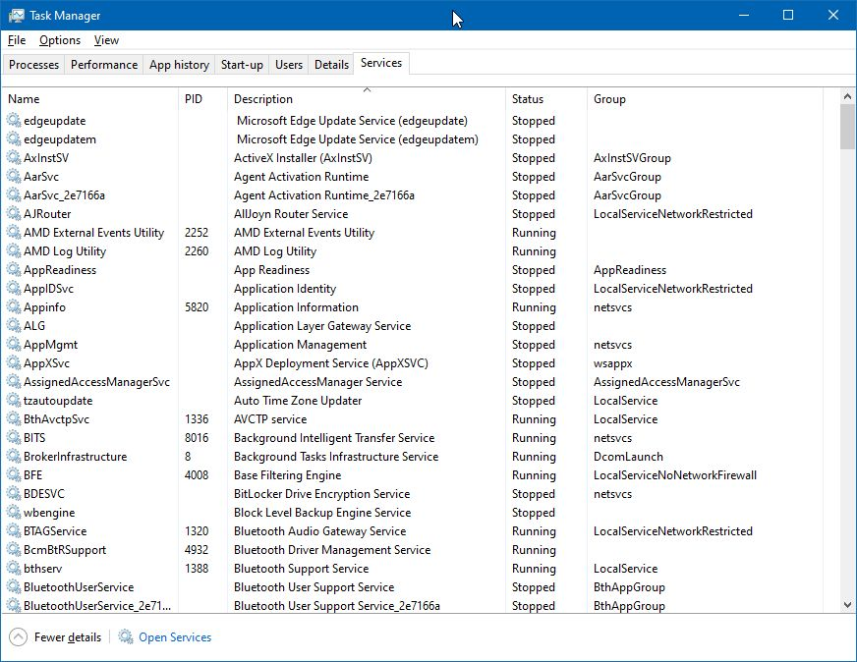
Task Manager: Services
“Services” are long-running processes
Every Service is a Process
Every Process is not a Service

Slide 14
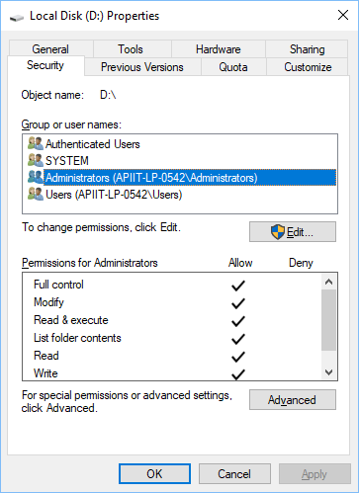
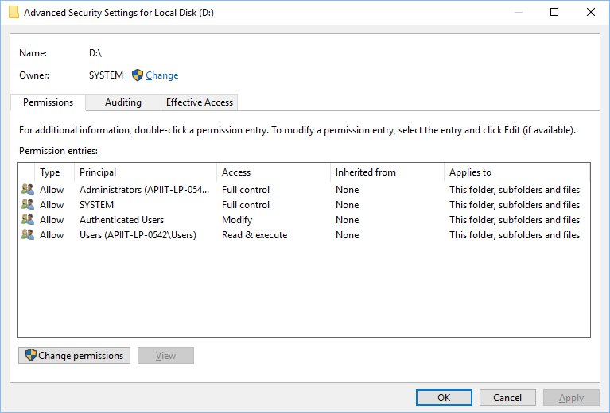
NTFS Permissions

Slide 15
To see file/folder permissions:
Right click on the file/folder >Go to “Properties” >Click on the “Security” tab
Permission | Description
List folder contents | View and list files and subfolders Execute files Inherited by folders only
Read | View and list files and subfolders View ownership, permissions, and attributes (Read-Only, Hidden, etc.)
Read & Execute | Read + Navigate through folders where you don’t have permission to get to files and subfolders for which you do have permissions Execute files
Write | Read & Execute + Write to a file, Add files and subfolders, Change attributes
Modify | Write + Delete files and folders
Full control | Modify + Change permissions settings for all files and subdirectories

Slide 16
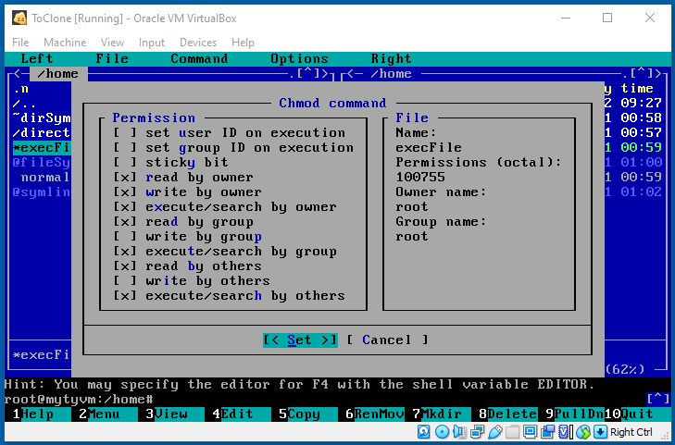
Linux Permissions
Not normally used
Numeric Representation:
Read = 4, Write = 2, Exec = 1
4 + 2 + 1 = 7
[Space] to turn on or off

Slide 17
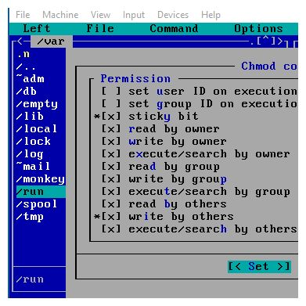
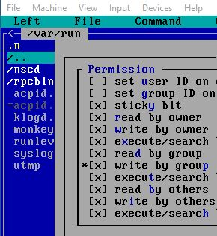


Special Directory Permissions
Sticky Bit (Directory Only):
Anyone can write a file
Only the owner can delete

Slide 19
Shared Libraries (.so) Dynamic Link Libraries (.dll)
Loaded into RAM on demand
Managed by some kernel routines which use an “index” to locate a required module
Special command used to do this – ldconfig
Must have the right libraries on your system
dependencies – missing or wrong version, cannot start
packages – bundle libraries, but often depend on others
package managers – help sort out dependencies
It is very likely that you will actually need to configure these, for one application or another
Notes:
Network Administration - Managing Hosts and Users
11/23/2021
19

Slide 20
Source and Packages
A Linux distribution is a collection of utilities bundled around the Linux kernel.
Source code is the program in text file format, usually written in the language C
A binary file is the result of compiled source code.
A dependency is a component of the system that must already be installed before another program will function.
Some, but not all, compilation scripts will attempt a dependency check prior to installation.

Slide 21
Source and Packages
Packages are pre-configured binary files for specific distributions.
Usually a compressed archive:
.tar.gz .tgz .lzip .bzip .rpm .deb {.cab}
Package managers keep track of which packages have been installed, and perform a dependency check when you install software
Some distributions offer a tracking service that will notify you when new versions of installed packages are available.
Others automatically download packages from an official repository
Debian/Ubuntu
Local – dpkg
Auto – apt-get
RedHat
Local – rpm
Auto – yum
Slackware
Local – pkgtool
Auto – (none)
Celebrate
Diversity!

